Slide 1

FFI – information 6/2
Strategic Vehicle Research and Innovation​

Slide 2
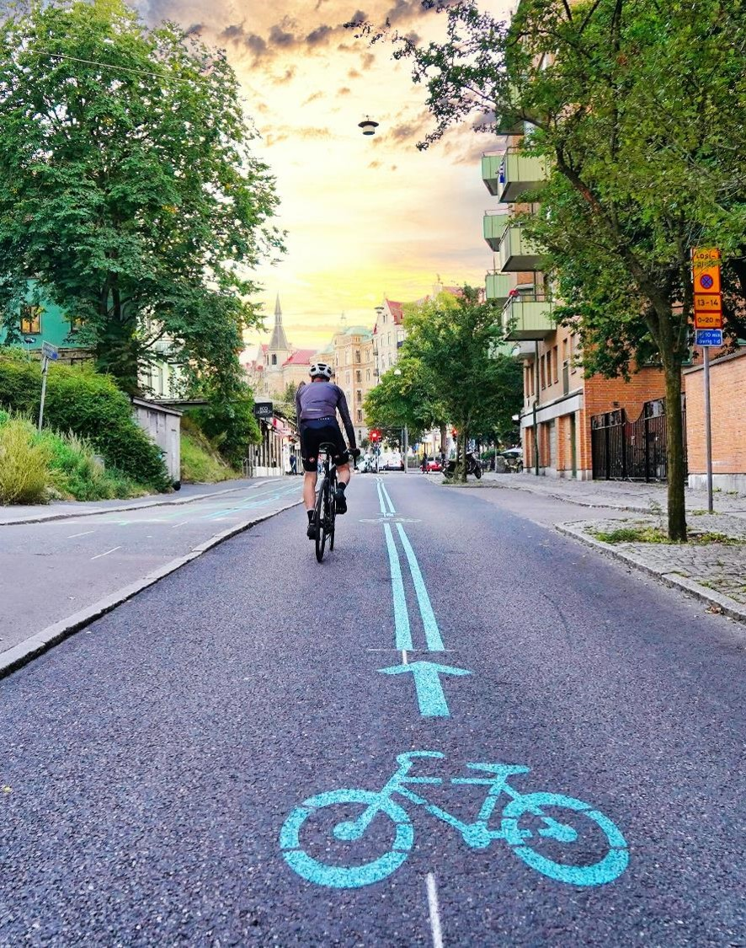
Welcome
Download this presentation from the FFI website:
https://ffisweden.se/kalendarium/informationsmote-om-fem-utlysningar-under-varen/
Questions? – Please use the chat
Would you like updates from us? Write your email in the chatt or register in our website: www.ffisweden.se

Slide 3

Agenda
FFI – short background
Presentations subprogrames
Important and practical information
Questions

Slide 4
What is FFI?

Slide 5
Cooperation since 2009
Our partners
Vinnova​
Swedish Transport Administration ​
Swedish Energy Agency​
Scania CV AB AB Volvo​
Volvo Car Group​
FKG - the Scandinavian Automotive Supplier Association​
Mobility Sweden (adjunct)
Funding programme - finances research, innovation and development for sustainable road transports ​
SEK 1 billion per year - the state accounts for half of the funding
Agreement between the state and the automotive industry

Slide 6
Our roadmap
Vision
Mission
FFI empower innovation for road transport aiming for a sustainable society
Sweden leads the global transition to sustainable road transport

Slide 7
Five subprogrames
Circularity
Transport- och mobility services
Zero Emission
Safe automated driving
Accelerate

Slide 8
Two calls for proposals each year

Slide 9
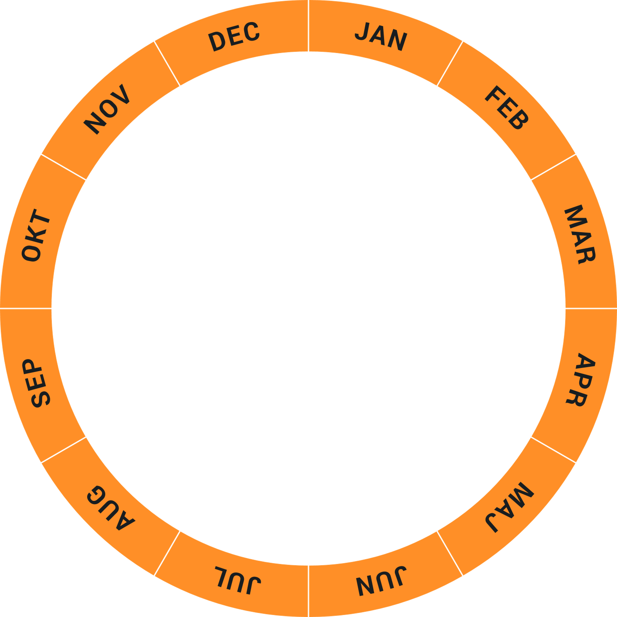
Timetable 2024
Decision
Open
Close
Calls for proposals 1
Calls for proposals 2
Close
Open
Decision

Slide 10
New website www.ffisweden.se

Slide 11

Accelerate

Slide 12

Accelerate
Focus on broad cooperation and major system demonstrations. Innovative system solutions with high societal benefits will be demonstrated on a large scale.
Projects within Accelerate:
Are large-scale and demonstrated in a real environment
Have a high level of technical maturity, are scalable and the potential to be implemented
Have established a strong and broad cooperation throughout the value chain
Include all five system perspectives
  Technology and products
  Business models and procurement
  Policy, regulations
  Behavior, culture
  Infrastructure

Slide 13
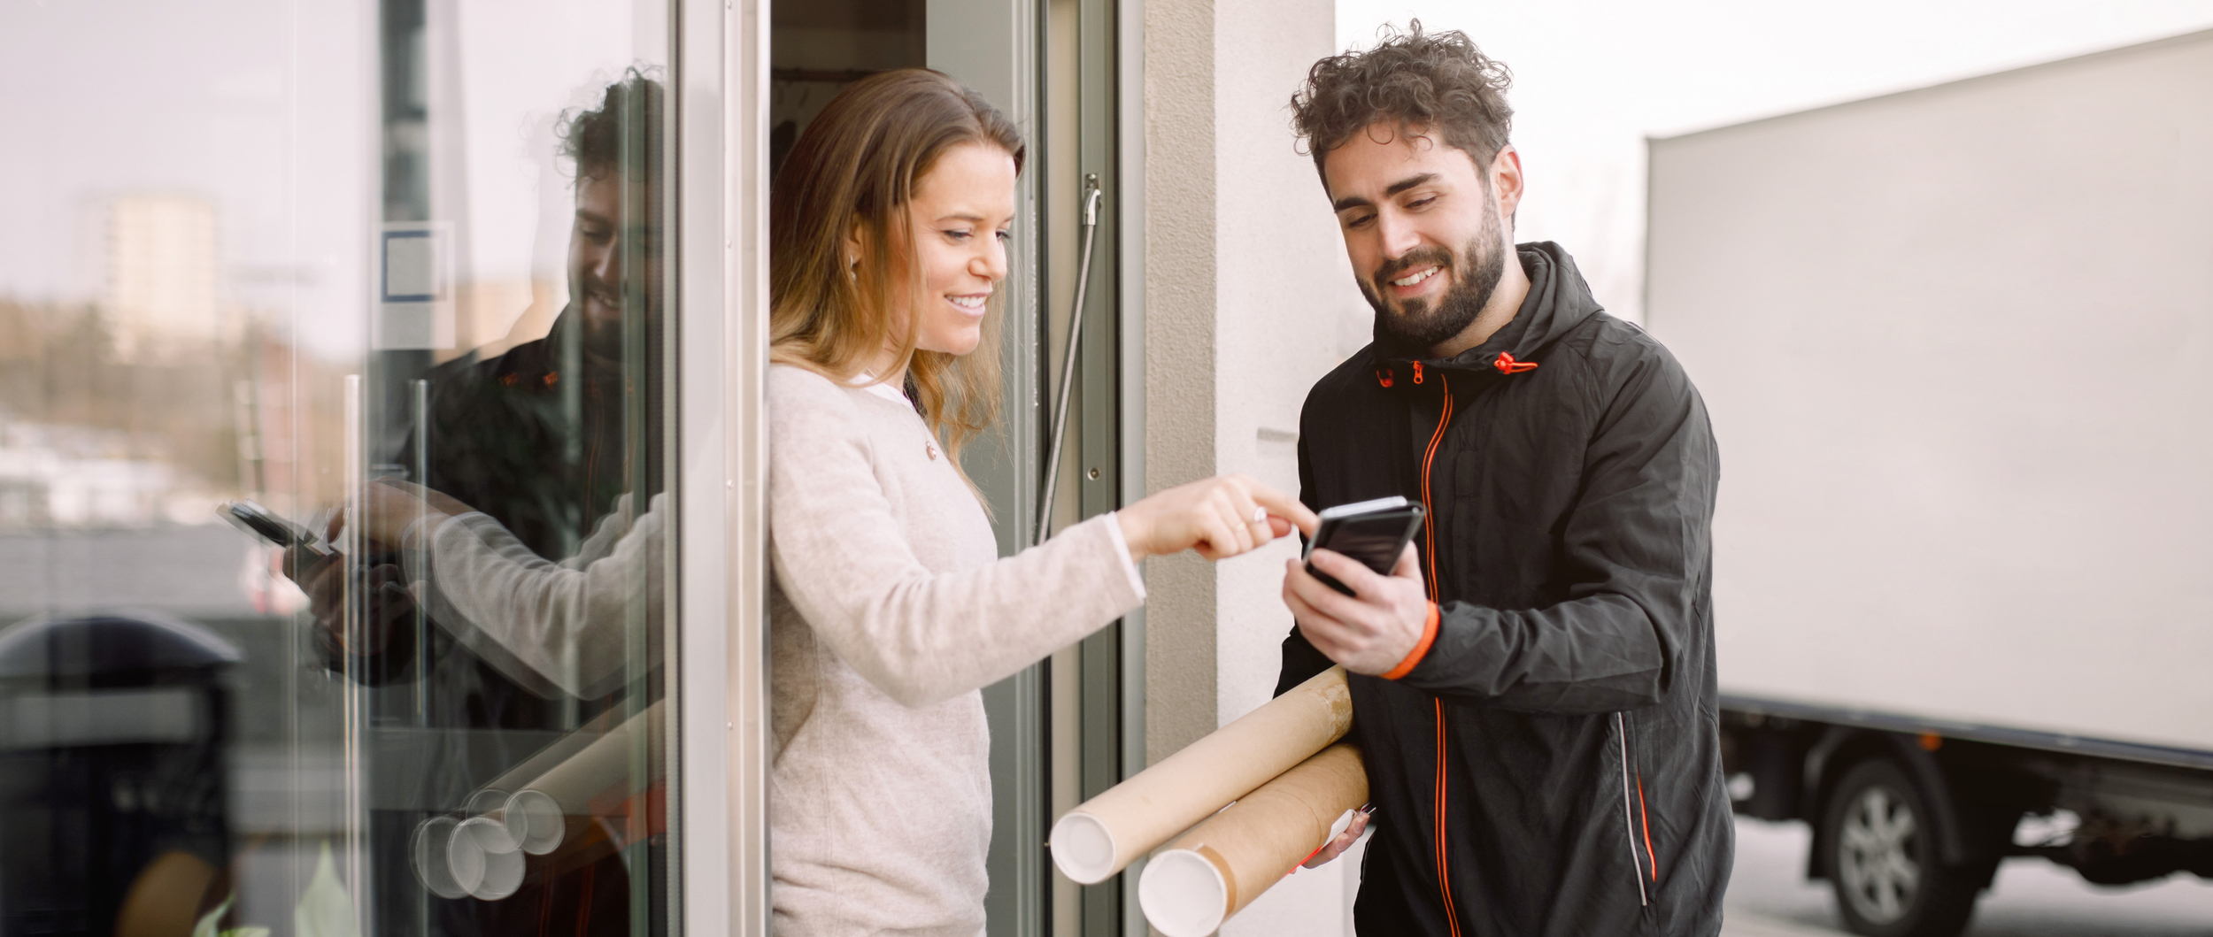
Transport and mobility services

Slide 14

Transport - and mobility services
The mission of the programme is to develop and test new innovative services and transport solutions that contribute to more efficient use of vehicles and transport systems. Focus on system perspectives.
Focus areas:
Testing solutions for resource efficient transport systems
Seamless intermodal transport solutions “door-to-door”
Seamless freight and goods transport solutions
New forms of collaboration
Development of digital platforms and enabling technologies from a holistic perspective

Slide 15
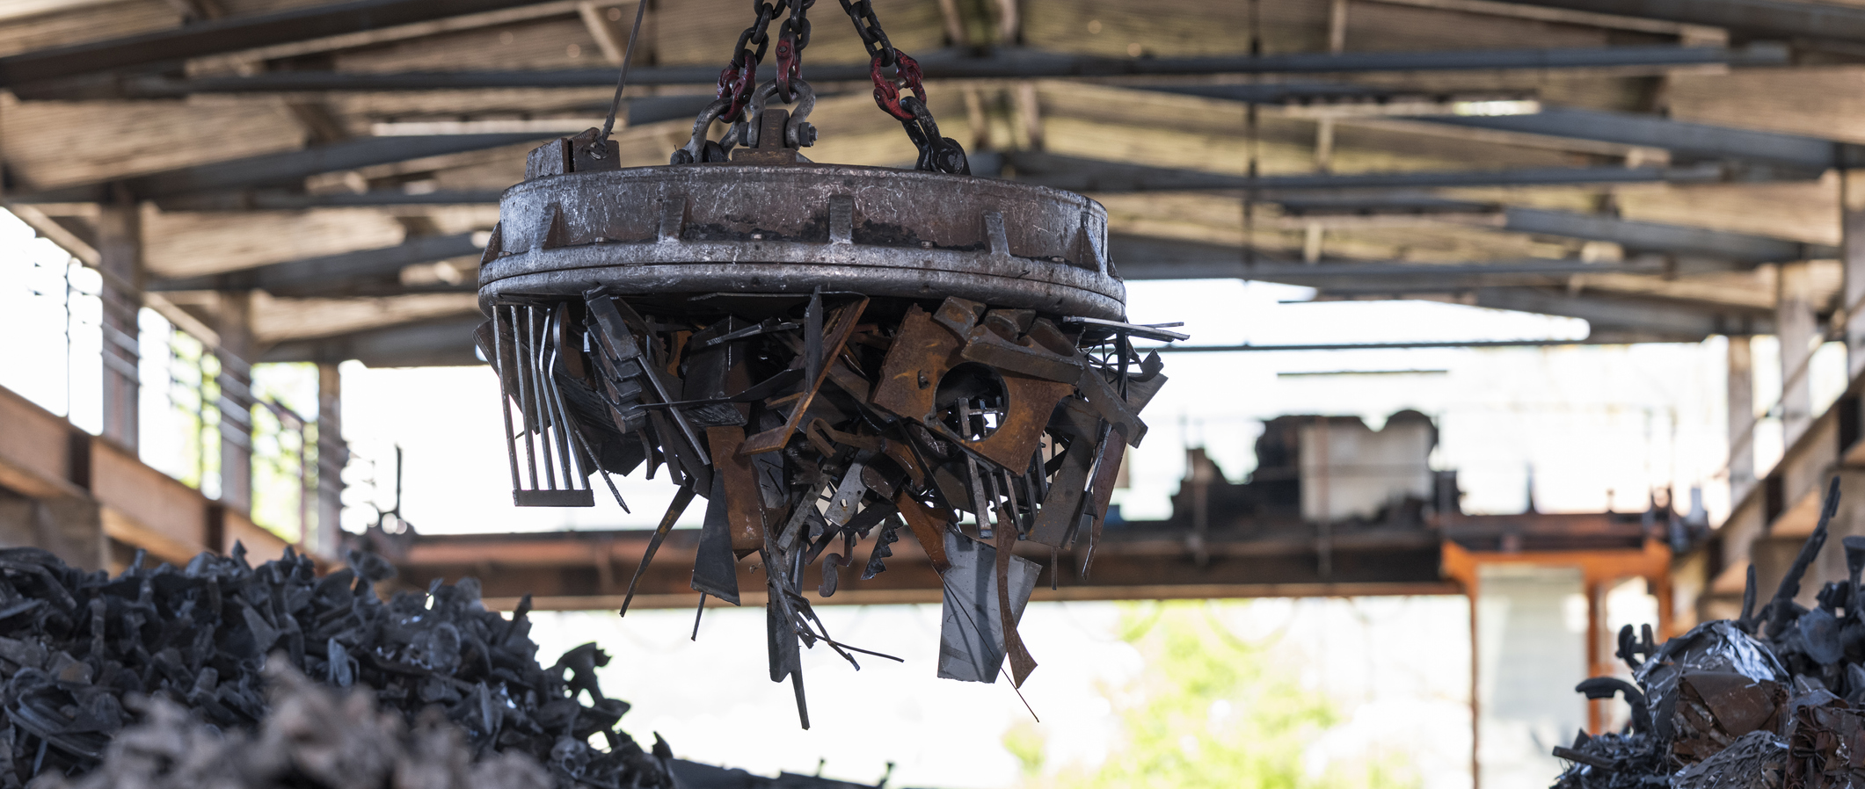
Cirkularity

Slide 16

Circularity
The mission is to minimise climate and environmental impacts from a life-cycle perspective and to strengthen sustainability throughout the value chain linked to the development, production and decommissioning of vehicles, including their components.
Focus areas:
Design for circularity
Social sustainability throughout the value chain
Climate neutral, circular manufacturing and recycling

Slide 17
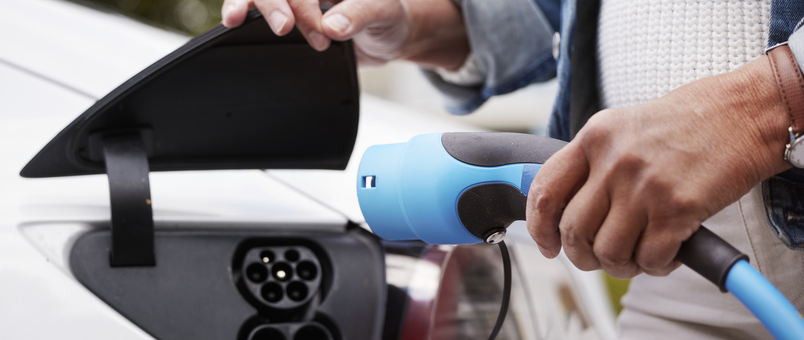
Zero Emissions

Slide 18

Zero Emissions
Reduce the negative impact of the automotive sector on climate and the environment by developing and integrating zero emission vehicles with their charging and refuelling infrastructure and with its users. Focus on system perspectives.
Focusareas:
Efficiency across the value chain from a sustainability perspective, e.g. for components and systems
Cost reduction balanced with climate benefits enabling implementation.
Optimised societal benefits such as adapting vehicles to behaviour and type of use
Hardware and software optimisation and electrical architecture in vehicles and charging and refuelling infrastructure
Safety, in-vehicle technology solutions and charging and refuelling infrastructure.

Slide 19
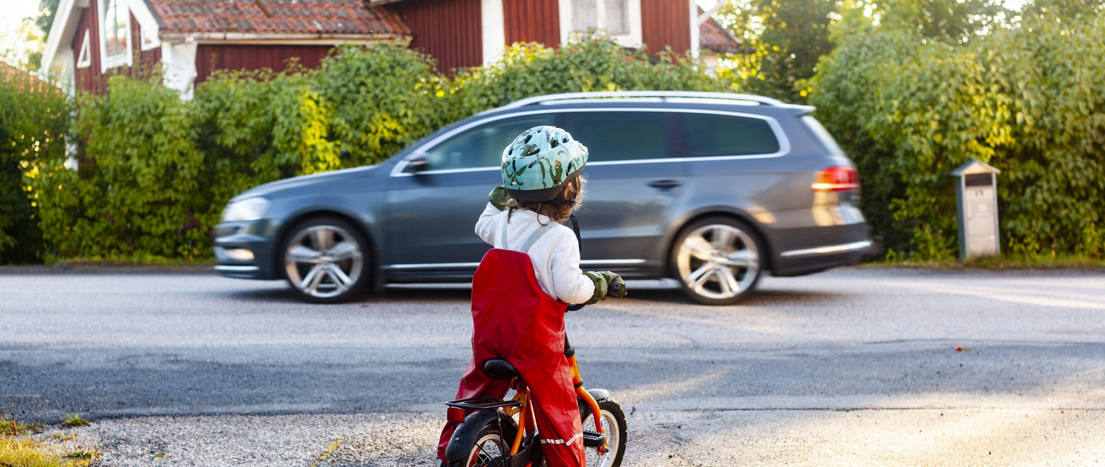
Safe automated driving

Slide 20

Safe automated driving
Improve road safety and make transport more sustainable through safe connected automated vehicles prepared for sharing. This call have a focus on system perspectives.
Focus areas:
Safe automated vehicles
Safety for road users inside and outside the vehicle
Integration of vehicles and infrastructure for safe transport solutions
Enabling methods and technologies with clear application for the development and deployment of safe automation

Slide 21
Important information

Slide 22

Important dates
Opens for application 2024-01-23
Last application date 2024-03-19 (14.00)
Decision given 2024-05-24
Projects to start earliest 2024-05-25
Projects allowed to start at latest 2024-08-16

Slide 23
Important dates FFI Zero emission
Opens for application 2023-12-11
Last application date 2024-03-19 (14.00)
Decision given 2024-09-30
Projects to start earliest 2024-05-06

Slide 24
How much can you apply?
Grants of a maximum of 50% for a subprogram​
Individual projects at least 25% funding from the industry​
Maximum amount for prestudies 500 000 sek​
Total budget this application​:
Accelerate approx 88 msek
Zero Emissions approx 60 msek
Circularity approx 37 msek
Safe automated driving approx 45 msek
Transport and mobilty services approx 35 msek
Notes:
Total budget this application​
Zero Emissions approx. 56 msek. ​
Circularity approx. 42 msek.​
Safe automated drivning approx. 55 msek.​
Transport and mobility services 50 msek

Slide 25

Projektpartners
  Minimum 2 projektpartners within Zeo Missions, Circularity, Transport and mobility services and Safe Automated Driving
  In Accelerate minimum 2 projektpartners in prestudies and 3 projektpartners in systemdemonstrations

Slide 26

Other important information
  Read the roadmap and call fo proosal text carefully
  Be in time
  Be careful with correct templates for the speficic subprograme​
  Don´t hesitate to contact us!

Slide 27

Application sites
  Zero Emission minasidor.energimyndigheten.se
  Four other subprogrammes E tjänster Vinnova

Slide 28
Important links
Roadmap – FFI Roadmap (ffisweden.se)
How to apply? Mallar och vägledning FFI
Q&A - Frågor och svar FFI
More information at our webbpage www.ffisweden.se

Slide 29




Contact
Circularity
tero.tjernstoft@vinnova.se
Transport- and mobility services
christian.fredricsson@vinnova.se
Zero Emissions
adam.mickiewicz@energimyndigheten.se
Safe automated driving
ulrika.landelius@trafikverket.se
Accelerate
anna.karlsson@vinnova.se
FFI
sofia.wieselfors@vinnova.se

Slide 30
More information www.ffisweden.se

Slide 31

Questions in the chat?

Slide 32
Thank you!

