Slide 1

FFI – information meeting
Strategic Vehicle Research and Innovation​

Slide 2
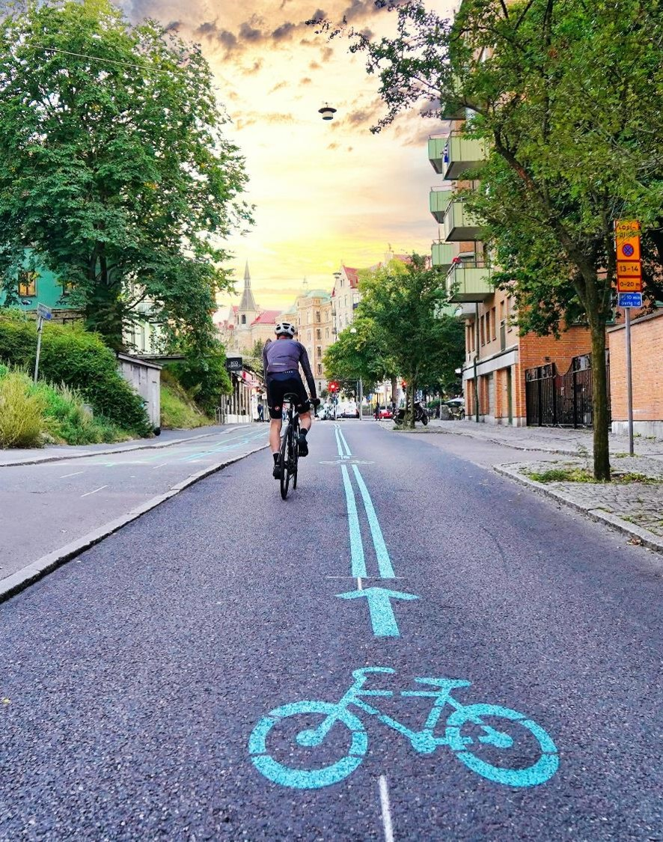
Welcome
General questions are welcome in the chat
Questions regarding a specific subprogramme – join a meeting with the subprogramme
Would you like to have updates from us? Register on our website: www.ffisweden.se

Slide 3

Agenda
FFI – introduction
Short subprogramme presentations
Important and practical information
General questions
Opportunity to meet one of the sub-programmes – see link to each meeting in the chat

Slide 4
What is FFI?

Slide 5
Cooperation since 2009
Our partners
Vinnova​
Swedish Transport Administration ​
Swedish Energy Agency​
Scania CV AB
AB Volvo​
Volvo Car Group​
FKG - the Scandinavian Automotive Supplier Association​
Mobility Sweden (adjunct)
Funding programme - finances research, innovation and development for sustainable road transports ​
SEK 1 billion per year - the state accounts for half of the funding
Agreement between the state and the automotive industry

Slide 6
Five subprogrames
Circularity
Transport- och mobility services
Zero Emission
Safe automated driving
Accelerate

Slide 7
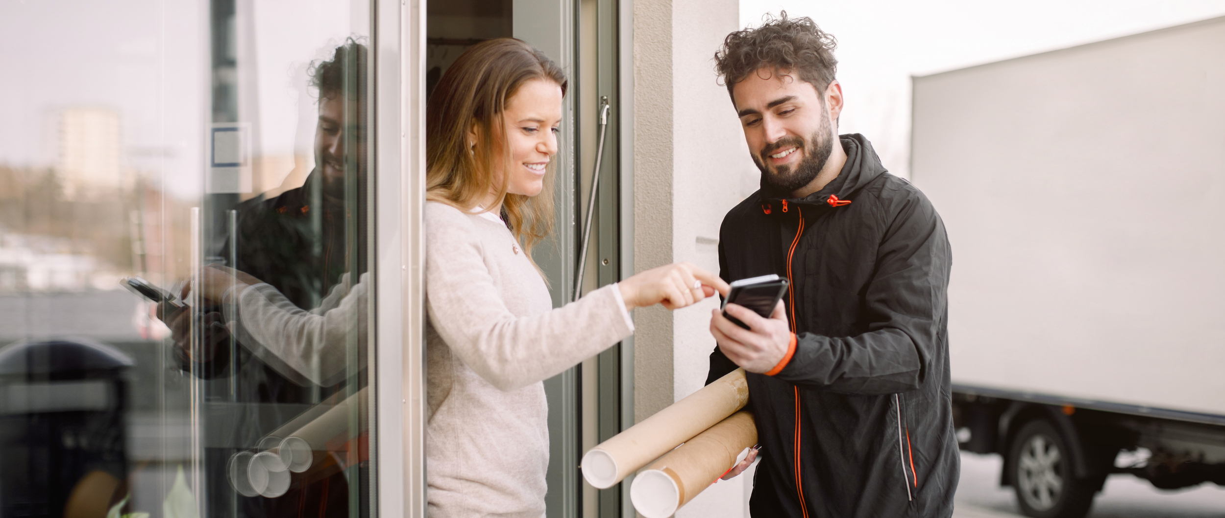
Transport and mobility services

Slide 8

Transport - and mobility services
Focus on efficient transport and mobility solutions that meet society’s sustainability, accessibility and resilience challenges.
Focus areas:
Vehicle technology and infrastructure.
Efficient transport solutions for freight and mobility
User-centred development
Methods and tools
Services and business models
Policy and regulation

Slide 9
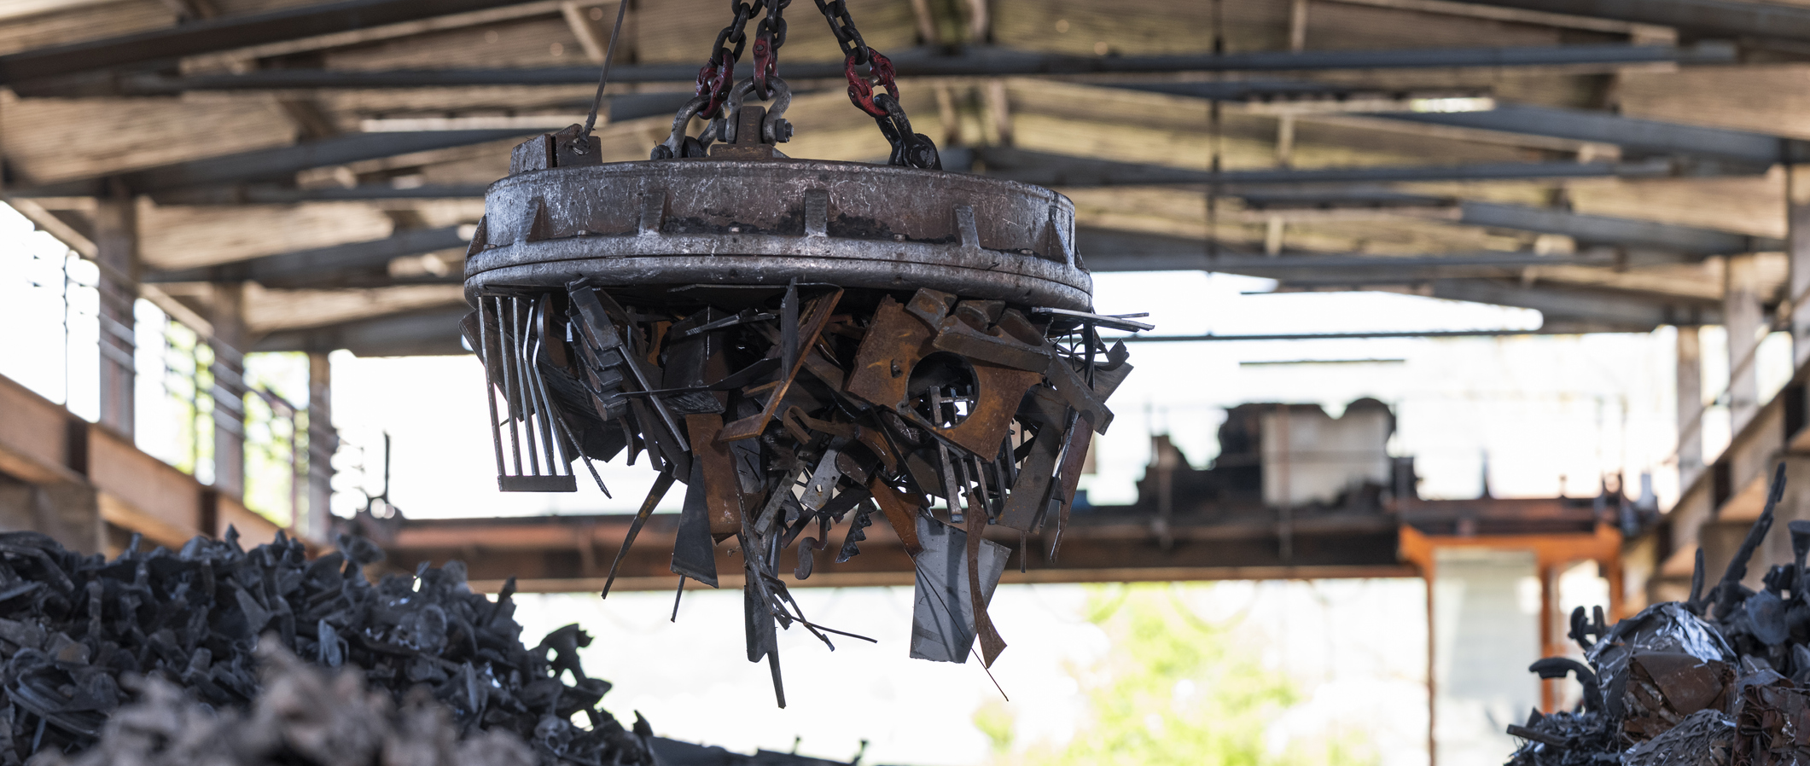
Circularity

Slide 10

Circularity
Focus on minimising the climate and environmental impact of manufacturing, service and decommissioning of vehicles.
Focus areas:
The product: Design for circularity and reduced environmental impact
The human: Skills, cognitive and physical support, the work environment as well as health and safety
The production system: Climate-neutral production, service and decommissioning

Slide 11
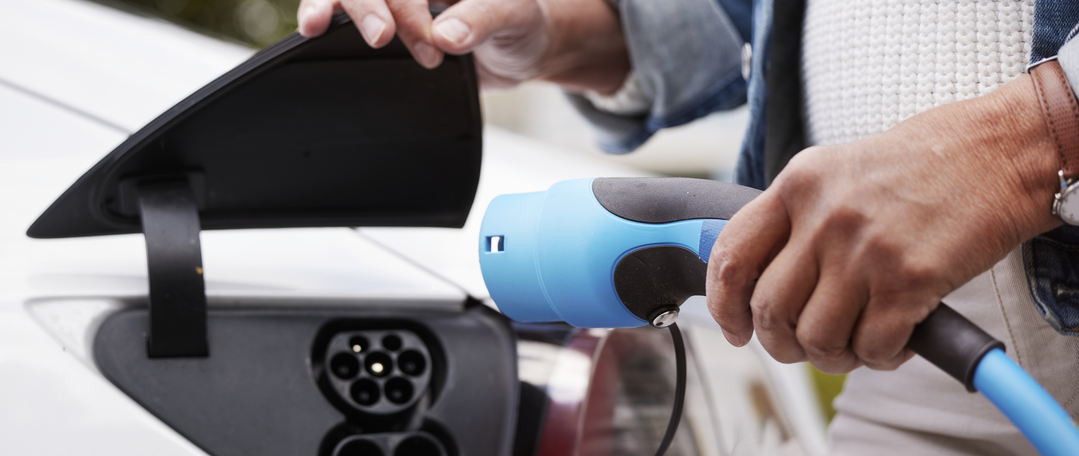
Zero Emissions

Slide 12

Zero Emissions
Focus on reducing the negative climate and environmental impact of vehicles in the use phase, in combination with user behaviour and charging and refuelling infrastructure.
Focusareas:
Policy development that keeps pace with technological and societal developments.
Hardware and software optimization
New, relatively unexplored technologies
Optimised energy efficiency in vehicles in the use phase
Power electronics in vehicles and infrastructure.

Slide 13
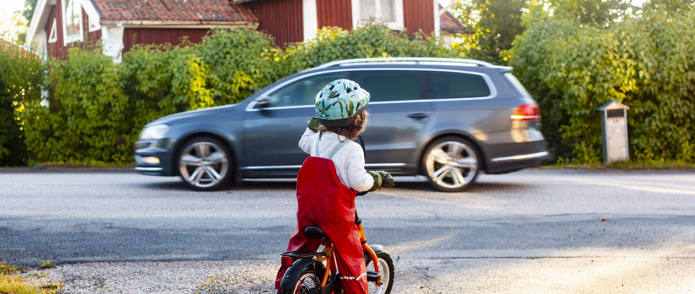
Safe automated driving

Slide 14

Safe automated driving
Focus on increasing road safety and making transportation more sustainable through safe, connected, automated vehicles prepared for next-generation transport systems.
Focus areas:
Safe automated vehicles
The safety of road users in and outside the vehicle
Integration of the vehicle with the transport system
Enabling methods and technologies
Demonstrations, pilot projects and field tests

Slide 15

Accelerate

Slide 16

Accelerate
Focus on accelerating transition through systems demonstrations, upscaling and demand-driven projects in which all dimensions of systems are addressed.
Projects within Accelerate:
Are large-scale and demonstrated in a real environment
Have a high level of technical maturity, are scalable and have the potential to be implemented
Have established a strong and broad cooperation throughout the value chain
Include all five system perspectives
  Technology and products
  Business models and procurement
  Policy, regulations
  Behavior, culture
  Infrastructure

Slide 17
Two calls for proposals each year

Slide 18
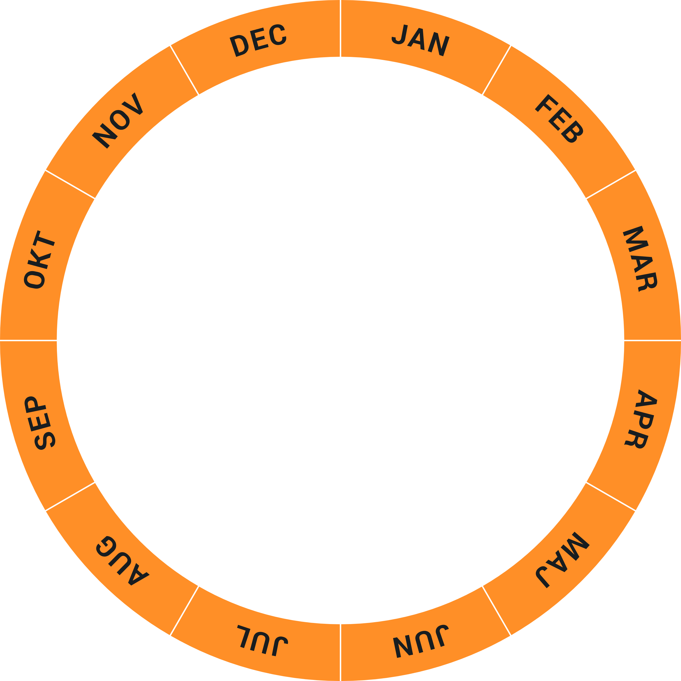
Timetable 2025
Opening
Decision
Closing
Calls for proposals 1
Calls for proposals 2
Closing
Opening
Decision

Slide 19
www.ffisweden.se

Slide 20
Important information

Slide 21

Important dates (Not Zero Emissions)
Opens for application 2025-01-23
Last application date 2025-03-19 kl.14.00
Decision given at latest 2025-05-16
Projects to start earliest 2025-05-19
Projects allowed to start at latest 2025-08-18

Slide 22
Important dates FFI Zero emission
Opens for application 2025-01-23
Last application date 2025-03-19 kl.23:59​
- Support until 16:00
Projects to start earliest 2025-05-15

Slide 23
How much can you apply?
Grants of a maximum of 50% for a subprogram​
Individual projects at least 25% funding from the industry​
Maximum amount for prestudies 500 000 sek​ (for Accelerate preparatory projects 750 000 sek)
Total budget this application​:
Accelerate approx 70 msek
Zero Emissions approx 60 msek
Circularity approx 40 msek
Safe automated driving approx 70 msek
Transport and mobilty services approx 35 msek
Notes:
Total budget this application​
Zero Emissions approx. 56 msek. ​
Circularity approx. 42 msek.​
Safe automated drivning approx. 55 msek.​
Transport and mobility services 50 msek

Slide 24

Project partners
  Minimum 2 project partners within Zero Emissions, Circularity, Transport and mobility services and Safe Automated Driving
  In Accelerate minimum 2 project partners in preparatory projects and 3 project partners in system demonstrations

Slide 25

Other important information
  Read the roadmap and call for proposal text carefully
  Make sure to submit the application before the deadline
  Make sure to use the correct templates for the specific subprogramme​
  Don´t hesitate to contact us!

Slide 26

Application sites
  Zero Emission minasidor.energimyndigheten.se
  Four other subprogrammes E tjänster Vinnova

Slide 27
Important links
Roadmap – FFI Roadmap
How to apply? Mallar och vägledning FFI
Q&A - Frågor och svar FFI
For more information, visit our webbpage www.ffisweden.se

Slide 28




Contact
Circularity
Frida.bjerke@vinnova.se
Transport- and mobility services
christian.fredricsson@vinnova.se and bjorn.svensbykurling@vinnova.se
Zero Emissions
magnus.henke@energimyndigheten.se
Safe automated driving
ulrika.landelius@trafikverket.se
Accelerate
catharina.zajcev@vinnova.se
FFI
sofia.wieselfors@vinnova.se

Slide 29
For more information www.ffisweden.se

Slide 30

Questions in the chat?

Slide 31
Thank you!

